Slide 1
Architecting Virtualized Infrastructure for Big Data
Richard McDougall
@richardmcdougll
CTO, Application Infrastructure, Big Data Lead, VMware, Inc

Slide 2
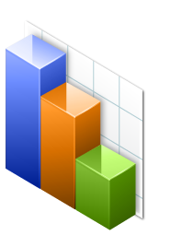









Cloud: Big Shifts in Simplification and Optimization
1. Reduce the Complexity
to simplify operations
and maintenance
2. Dramatically Lower Costs
to redirect investment into value-add opportunities
3. Enable Flexible, Agile
IT Service Delivery
to meet and anticipate the needs of the business

Slide 3
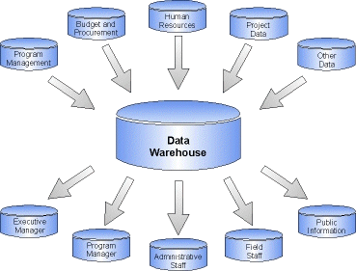

Infrastructure, Apps and now Data…
Build
Run
Private
Public
Manage
Simplify Infrastructure
With Cloud
Simplify App Platform
Through PaaS
Simplify Data

Slide 4
Trend 1/3: New Data Growing at 60% Y/Y
Exabytes of information stored
20 Zetta by 2015
1 Yotta by 2030
Yes, you are part
of the yotta
generation…
audio
digital tv
digital photos
camera phones, rfid
medical imaging, sensors
satellite images, games, scanners, twitter
cad/cam, appliances, videoconfercing, digital movies
Source: The Information Explosion, 2009

Slide 5
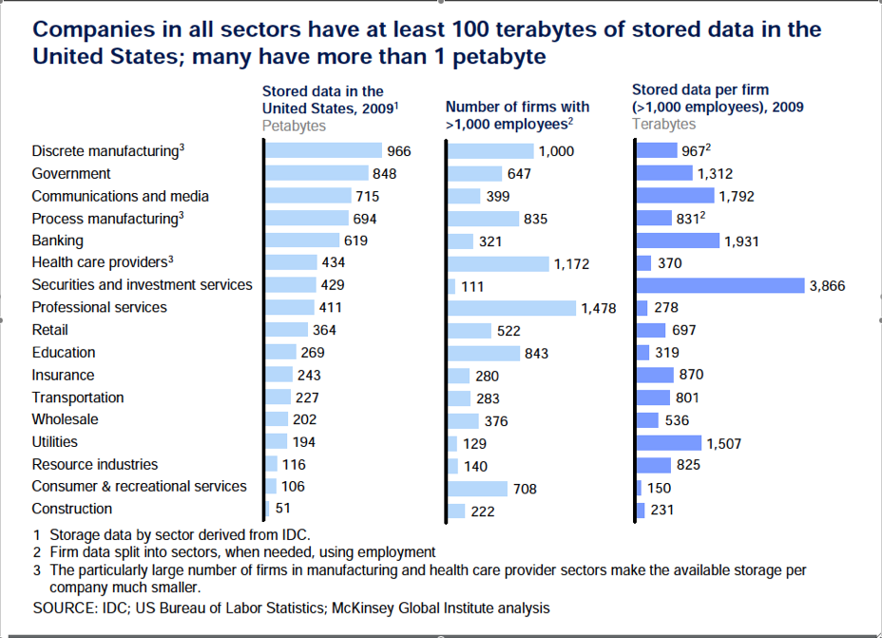
Data Growth in the Enterprise

Slide 6



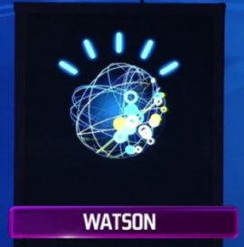
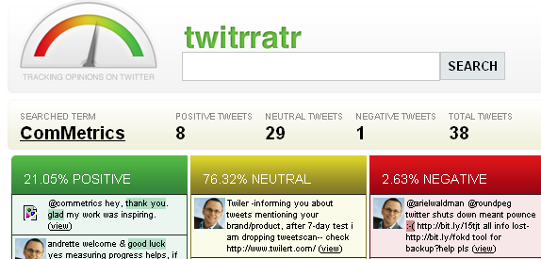

Trend 2/3: Big Data – Driven by Real-World Benefit

Slide 7
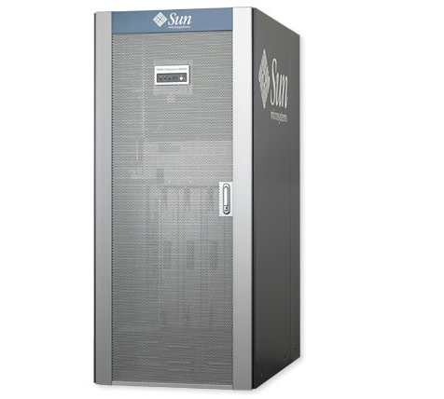
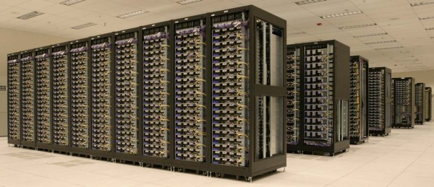
Trend 3/3: Value from Data Exceeds Hardware Cost
Value from the intelligence of data analytics now outstrips the cost of hardware
  Hadoop enables the use of 10x lower cost hardware
  Hardware cost halving every 18mo
Value
Big Iron:
$40k/CPU
Commodity
Cluster:
$1k/CPU
Cost

Slide 8
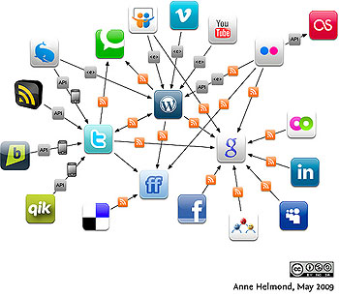

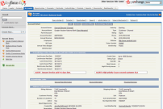
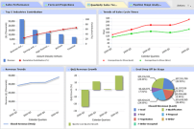


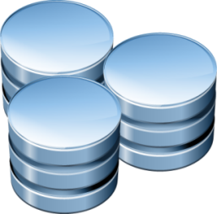
A Holistic View of a Big Data System:
Real Time
Streams
Real-Time
Processing
(s4, storm)
Analytics
ETL
Real Time
Structured
Database
(hBase, Gemfire, Cassandra)
Big SQL
(Greenplum,
AsterData,
Etc…)
Batch
Processing
Unstructured Data (HDFS)

Slide 9
Big Data Frameworks and Characteristics
Framework | Scale of data | Scale of Cluster | Computable Data? | Local Disks?
File System: Gluster, Isilon, etc,… | 10s PB | 100s | No | Yes, for cost
Map-reduce: Hadoop | 100s PB | 1,000s | Yes | Yes, for cost and bandwidth
Big-SQL: Greenplum, Aster Data, Netezza, … | PB’s | 100s | No | Yes, for cost and bandwidth
No-SQL: Cassandra, hBase, … | Trilions Of rows | 100s | Future | Yes, for cost and availability
In-Memory: Redis, Gemfire, Membase, … | Billions of rows | 10s-100s | Hybrid Possible | Primarily Memory

Slide 10
The Unified Analytics Cloud Platform
Analytics Tools
Madlib
Karmasphere
Data Meer
Tableau
Spring
Developer
Frameworks
Hadoop
PaaS
Python
Cloudfoundry
Cassandra
Database/DataStore
HDFS
hBase
Greenplum
Voldemort
Data Platform
Data-Director
Data PaaS
EMC Chorus
Cloud Infrastructure
vSphere
Private
Public

Slide 11
Unifying the Big Data Platform using Virtualization
Goals
  Make it fast and easy to provision new data Clusters on Demand
  Allow Mixing of Workloads
  Leverage virtual machines to provide isolation (esp. for Multi-tenant)
  Optimize data performance based on virtual topologies
  Make the system reliable based on virtual topologies
Leveraging Virtualization
  Elastic scale
  Use high-availability to protect key services, e.g., Hadoop’s namenode/job tracker
  Resource controls and sharing: re-use underutilized memory, cpu
  Prioritize Workloads: limit or guarantee resource usage in a mixed environment

Slide 12
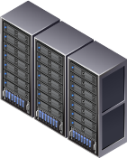
A Unified Analytics Cloud Significantly Simplifies
Simplify
  Single Hardware Infrastructure
  Faster/Easier provisioning
SQLCluster
Big SQL
NoSQL
Hadoop
NoSQL Cluster
Unifed Analytics Infrastructure
Private
Public
Hadoop Cluster
Optimize
  Shared Resources = higher utilization
  Elastic resources = faster on-demand access
Decision Support Cluster

Slide 13




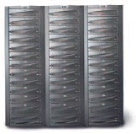
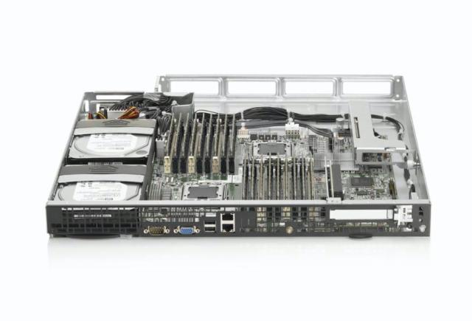
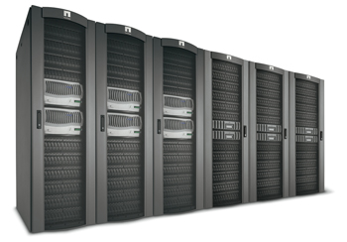
Use Local Disk where it’s Needed
SAN Storage
$2 - $10/Gigabyte
$1M gets:
0.5Petabytes
200,000 IOPS
1Gbyte/sec
NAS Filers
$1 - $5/Gigabyte
$1M gets:
1 Petabyte
400,000 IOPS
2Gbyte/sec
Local Storage
$0.05/Gigabyte
$1M gets:
20 Petabytes
10,000,000 IOPS
800 Gbytes/sec

Slide 14


VMware is Commited to the Best Virtual platform for Hadoop
Performance Studies and Best Practices
  Studies through 2010-2011 of Hadoop 0.20 on vSphere 5
  White paper, including detailed configurations and recommendations
Making Hadoop run well on vSphere
  Performance optimizations in vSphere releases
  VMware engagement in Hadoop Community effort
  Supporting key partners with their distibutions on vSphere
  Contributing enhancements to Hadoop
Hadoop Framework Integration
  Spring Hadoop: Enabling Spring to simplify Map-Reduce Programming
  Spring Batch: Sophisticated batch management (Oozie on steroids)

Slide 15
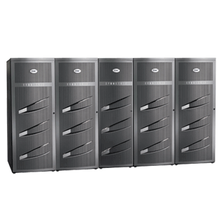
Extend Virtual Storage Architecture to Include Local Disk
Shared Storage: SAN or NAS
  Easy to provision
  Automated cluster rebalancing
Hybrid Storage
  SAN for boot images, VMs, other workloads
  Local disk for Hadoop & HDFS
  Scalable Bandwidth, Lower Cost/GB
Hadoop
Other VM
Other VM
Hadoop
Hadoop
Other VM
Hadoop
Hadoop
Other VM
Hadoop
Other VM
Other VM
Hadoop
Hadoop
Other VM
Hadoop
Hadoop
Other VM
Host
Host
Host
Host
Host
Host

Slide 16
Performance Analysis of Big Data (Hadoop) on Virtualization
Ratio of time taken – Lower is Better
Tested on vSphere 5.0

Slide 17
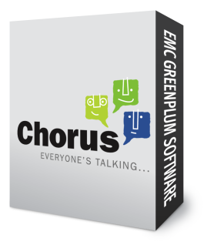
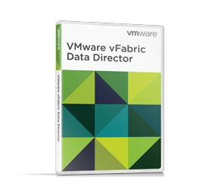
Simplify Hetrogeneous Data Management via Data PaaS
File-system
Large-Scale
NoSQL
In-Memory
Big SQL
Analytics Tools
Developer
Data PaaS – Common Data Management Layer
Databases
Data Platform
Provisioning
Multi-tenancy
Import/Export
Cloud Infrastructure
Management
Data Discovery
Cloud Infrastructure

Slide 18
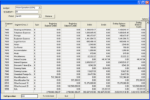
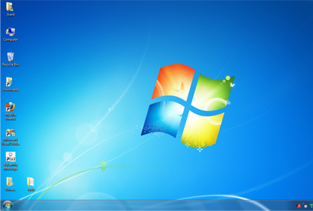



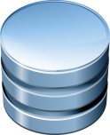


vFabric Data Director Powers Database-as-a-Service
Existing Applications
New Applications
vFabric Data Director
Automation
Self-Service
Provisioning
Backup/
Restore
Clone
One click
HA
DBA
App Dev
Policy Based
Control
Resource
Mgmt
Security
Mgmt
Database
Templates
Monitor
DBA
IT Admin
VMware vSphere
Notes:
Let’s take a closer look at data director, data director and built on top of vsphere platform, and provides a single pane to monitor and manage 1000’s of database.
The core capabilities of Data Director can be view from two perspectives.
The first set of capabilities are targeted at the database users which are DBAs or application developers. We talked about a few slides ago on long lead time required for database operations to be carried out due semi-manual database operations, involvement from multiple IT teams. With data director, we have fully automated common database operations and cut across the silos of the IT organization. Now operations like provisioning, backup, restore, cloning and HA, can be done through a few clicks in a self service fashion. The result is for application developer to spend more time coding and less time waiting.
This second set is are targeted at DBaaS operators, that provides IT with the necessary tools to enforce control and compliance over databases. With self-service to empower developers, at the same time, it’s also important for IT to maintain control. Data Director provides a myriad of features to allow IT to control resource usage, access and templates to maintain standardization, so you can feel comfortable empowering your developers.

Slide 19
Data Systems: Databases, file systems
Analytics Tools
Unstructured
Structured
Developer
Databases
File-system
Large-Scale
NoSQL
In-Memory
Big SQL
Data Platform
Cloud Infrastructure

Slide 20
Technology: Databases and Data Stores for Big Data
Unstructured
Structured
File-system
Large-Scale
NoSQL
In-Memory
Big SQL
Types of Data | Log files, machine generated data, documents, device data, etc… | Loosely typed device data, records, events, statistics, complex relations/graphs | Structured, partitionable data | Structured data
Techno-logies | NAS, HDFS, Blob (S3, Atmos, etc..) | Cassandra, hBase, Voldemort | Gemfire, Redis, Membase | Greenplum, Sybase IQ, Aster Data, etc,.
Values | Store any data, easy to scale-out, can optimize for cost | Easy to scale-out, flexible and dynamic schema’s | High Throughput, low latency | High performance for repetitive queries. Ease of query language.

Slide 21




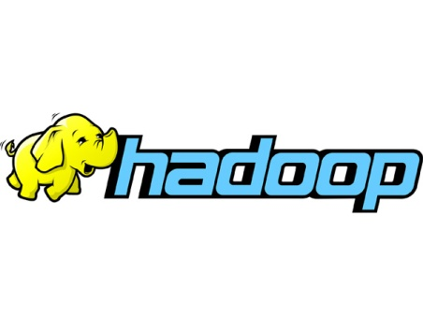
Simplified Developer Experience through PaaS
Analytics Tools
Developer
Databases
Data Platform
Platform as a Service
Cloud Infrastructure

Slide 22
Spring Big Data Integrations
NoSQL Integration
  Spring data for MongoDB, Gemfire, Riak, Neo4j, Blob, Cassandra
Spring Hadoop
  Announced this week at Strata!
  Provides support for developing applications based on Hadoop technologies by leveraging the capabilities of the Spring ecosystem.
Spring Batch
  Integration allows Hadoop jobs and HDFS operations as part of workflow

Slide 23
The Unified Analytics Cloud Platform
Analytics Tools
Madlib
Karmasphere
Data Meer
Tableau
Spring
Developer
Frameworks
Hadoop
PaaS
Python
Cloudfoundry
Cassandra
Database/DataStore
HDFS
hBase
Greenplum
Voldemort
Data Platform
Data-Director
Data PaaS
EMC Chorus
Cloud Infrastructure
vSphere
Private
Public

Slide 24
Summary
Revolution in Big Data is under way
  Data centric applications are now critical
Hadoop on Virtualization
  Proven performance
  Cloud/Virtualization values apparent for Hadoop use
Simplify through a Unified Analytics Cloud
  One Platform for today’s and future big-data systems
  Better Utilization
  Faster deployment, elastic resources
  Secure, Isolated, Multi-tenant capability for Analytics

Slide 25
References
Twitter
  @richardmcdougll
My CTO Blog
  http://communities.vmware.com/community/vmtn/cto/cloud
Hadoop on vSphere
  Talk @ Hadoop World
  Performance Paper – http://www.vmware.com/files/.../VMW-Hadoop-Performance-vSphere5.pdf
Spring Hadoop
  http://blog.springsource.org/2012/02/29/introducing-spring-hadoop

